Slide 1


MS Excel

Slide 2
Contents
Introduction
Interface & Tools 3. Formatting
Formula & Calculations
SUM, AVERAGE, MAX, MIN
Percentage formula
IF Condition
Sorting
Filter
Charts

Slide 3
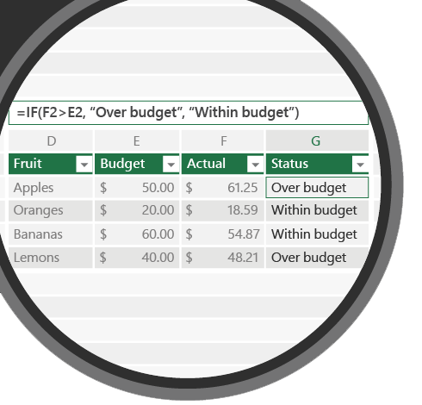
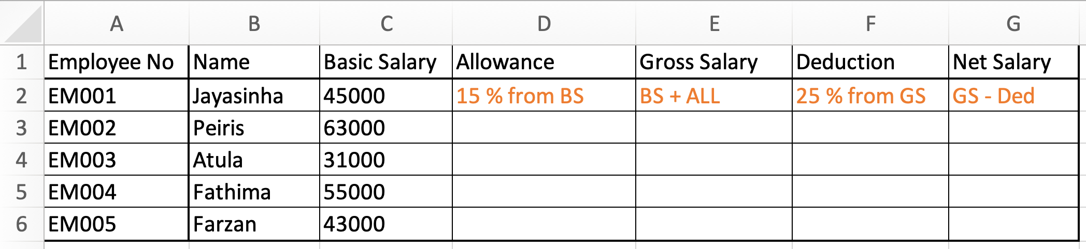
4.2
%
Allowance, Deduction

Slide 4
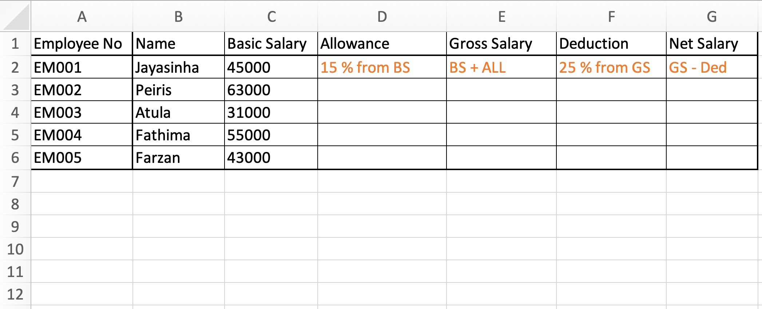
4.2 Question
Q1. Correct formula to first row of Allowance?
a. =BS*15/100
b. =C2*15/100
c. =ALL*15/100

Slide 5
4.2 Question
Q2. Select correct way of finding Gross salary?
a. =SUM(C2+D2)
b. =(C2+D2)
c. =C2+D2

Slide 6
4.2 Question
Q3. find suitable formula to calculate Deduction?
a. =GS*25/100
b. =E3*25/100
c. =69750*25/100

Slide 7
Revision
4.2 Question
Q1. Correct formula to first row of Allowance?
a. =BS*15/100
b. =C2*15/100
c. =ALL*15/100
Q2. Select correct way of finding Gross salary?
a. =SUM(C2+D2)
b. =(C2+D2)
c. =C2+D2
Q3. find suitable formula to calculate Deduction?
a. =GS*25/100
b. =E3*25/100
c. =69750*25/100

Slide 8
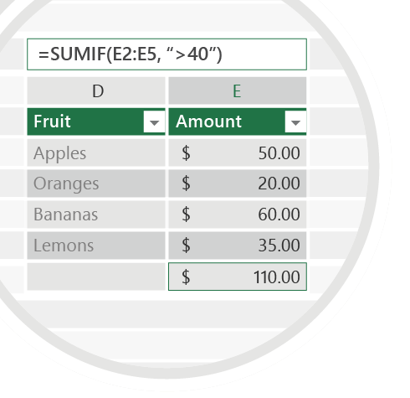

Exercise 4.2
Check your email for Question 4.2.pdf
Fill all the blanks with correct formula and mail us your work for below mentioned email id
Emails
TO : shalomshan089@gmail.com

Slide 9


